Slide 1

PRESENTATION ON 5G TECHNOLOGY
presented by-
ANKIT KUMAR(17CS91)
B.Tech VIIth sem
Computer Science & Engineering

Slide 2
OUTLINE
Introduction
Evolution from 1G to 5G
Comparison of 1G to 5G
Deployment of 5G
Architecture
Application
Advantages
Government’s steps
Challenges
Conclusion

Slide 3
Introduction to 5G
What is 5G ?
What does it offer ?

Slide 4
What is 5G ?
5G is the latest iteration of cellular technology, engineered to greatly increase the speed and responsiveness of wireless network.
Complete wireless communication with almost no limitation
Can be called REAL wireless world
Has incredible transmission speed

Slide 5
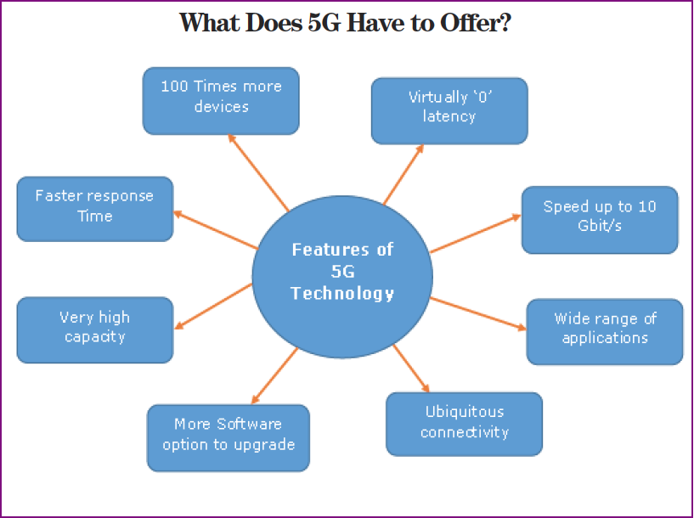
What does it offer?
World wide cellular phones
Low Latency
Extraordinary data capabilities
High connectivity
No Network congestion.
Connectivity to a full circle
Large phone memory , more
dialing speed, more clarity in
audio & video

Slide 6
Evolution from 1G to 5G
1G
2G
3G
4G
5G

Slide 7
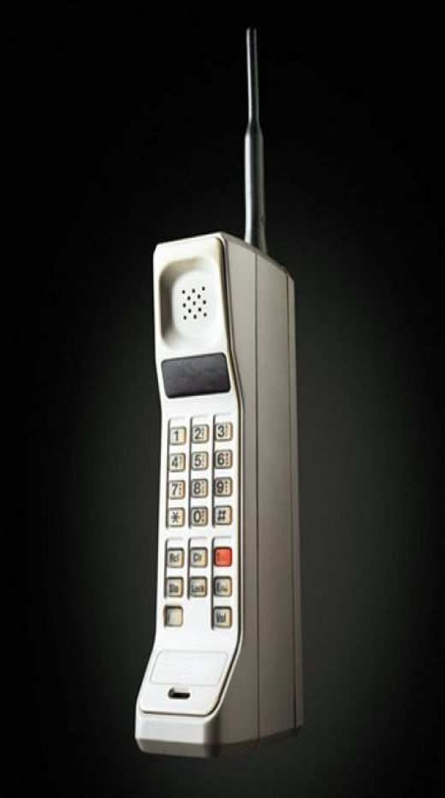
Evolution from 1G to 5G
1G wireless system:
Developed in 1980s.
Based on analog system.
Speed up to 2.4kbps
Supported only voice call.
Allows users to make voice calls in 1 country

Slide 8
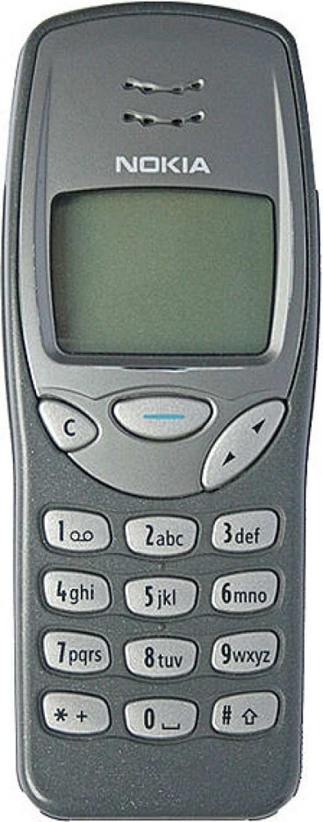
Evolution from 1G to 5G
2G wireless system:
Launched in 1990s.
Based on digital system.
Speed up to 64kbps
Services such as digital voice & SMS with more
clarity

Slide 9
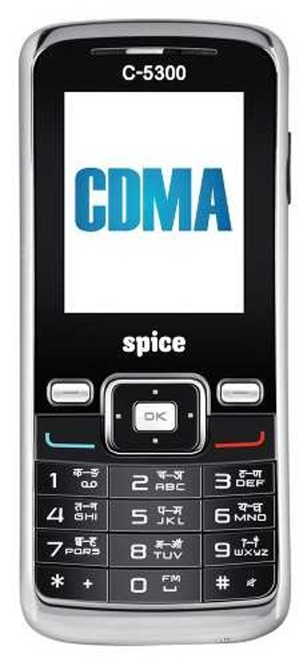
Evolution from 1G to 5G
2.5G wireless system
Generation between 2G and 3G
2.5G represents handsets with data
capabilities over GPRS
Failure in bringing any new evolution

Slide 10
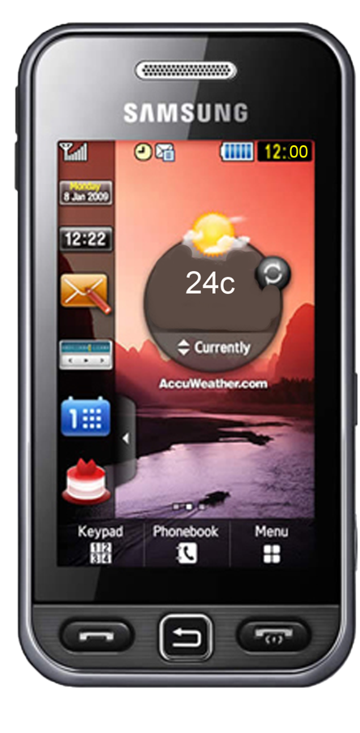
Evolution from 1G to 5G
3G wireless system
Launched in 2000s.
Speeds from 125kbps-2Mbps
Data sent through packet switching
technology
Access to Global Roaming & Clarity in voice
calls
Fast Communication, Internet, Mobile T.V,
Video Conferencing, Video Calls, (MMS),
3D gaming etc

Slide 11
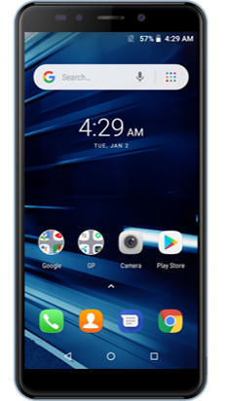
Evolution from 1G to 5G
4G wireless system:
Developed in 2010.
Faster and more reliable
Speed up to 100 Mbps
High performance
Easy Roaming
Low cost

Slide 12
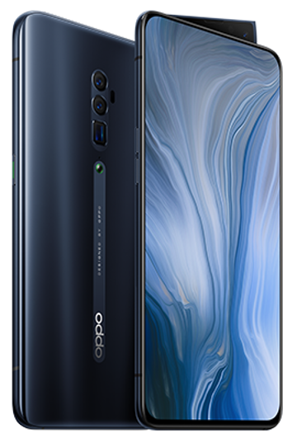
Evolution from 1G to 5G
5G wireless system
Next major phase of mobile
telecommunication & wireless system
10 times more capacity than others
Expected speed up to 1 Gbps
More faster and reliable than 4G
Lower cost than previous generation

Slide 13
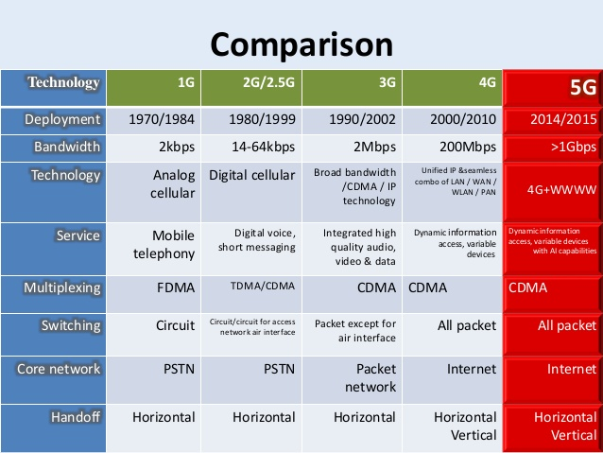
Comparison of 1G to 5G Technologies

Slide 14
Deployment of 5G:
Its deployment will happen with the auction of the millimeter-wave spectrum i.e. the frequency range of 28-100GHz.
In this area India is not fully prepared and that’s why 5G implementation will take more time.
Three mobile carriers of U.S. - Sprint, T-Mobile and Verizon have taken the task to upgrade the existing 4G infrastructure to 5G. Verizon has already launched its 5G home service in Houston, Indianapolis, Los Angeles and Sacramento.

Slide 15
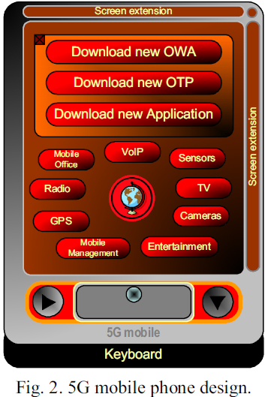
ARCHITECTURE OF 5G:

Slide 16
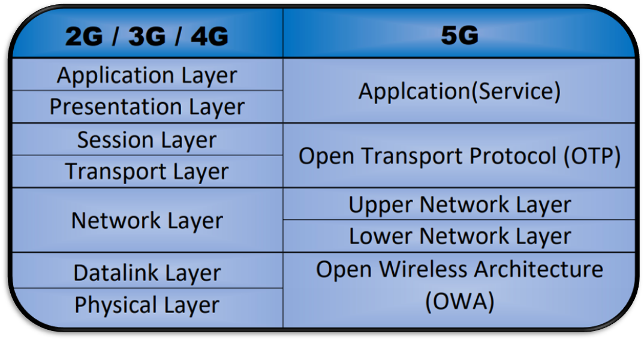
Architecture…….

Slide 17
ARCHITECTURE…..
OWA – This layer is used to define the wireless technology to be used.
Physical Layer + Data Link Layer = OWA
Network layer is divided into two sub layers
1. Lower Network Layer
2. Upper Network Layer
Network layer is used to route the data from source to destination.

Slide 18
ARCHITECTURE….
Open transport layer perform the operation of both transport and session layer.
Transport Layer + Session Layer = OTL
Application Layer is responsible for providing good quality of service.
Application Layer makes the data into proper format i.e. it decrypt the data which is encrypted form

Slide 19
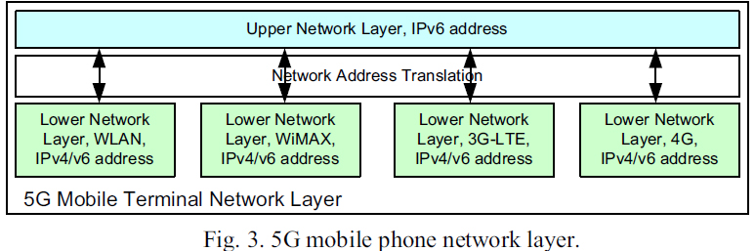

Slide 20
Application of 5G:
High-Speed mobile network
Entertainment and multimedia.
Internet of Things
Smart cities
Smart farming
Controlling of critical infrastructure and vehicle
Industrial application

Slide 21
Advantages of 5G
5G is expected to offer enhanced mobile broadband that can meet high coverage requirements.
High data speed of 5G network might help cloud systems to stream software updates , music , and navigation data.
Provide ecosystem for IOT.
It will help in digital growth of country that will result in rise of GDP and employment generation in the country.

Slide 22
Government’s Steps :
National Electronics Policy 2019 aims to position India as a global hub for Electronics System Design and Manufacturing and promotes early stage Start-ups in emerging technology areas such as 5G, loT, Artificial Intelligence etc.
Indian government also initiated measures to introduce 5G technology via the National Telecom Policy (NTP), which aims to reach 100% teledensity, highspeed internet highways and delivery of citizen-centric services electronically.
The Department of Telecommunications set up a high-level forum to develop the roadmap for 5G services in India by 2020

Slide 23
Continue……
The government is also working on creating a corpus of Rs 500 crore for research and development for 5G technology in India.
The government has invited leading telecom companies to undertake pilot projects on spectrum allocated free of charge for a year.

Slide 24
Challenges:
Many of the old devices will need to be replaced as they are not supporting 5G .
The switch from 4G to 5G will be infrastructure intensive and development of infrastructure for 5G is very expensive.
The transition experience from one technology generation to another is not very good as one has to buy a whole another phone to start using latest cellular technology, thereby creating financial liability.
There are expected to be 20 billion connected devices in the world by 2020 and as a result data will become highly distributed. It will be a new challenge to manage, analyze, store and protect data, irrespective of where it exists.

Slide 25
CONCLUSION
The arrival of 5G-enabling smart devices will change the way we live & think and can be a game changer for better service delivery, faster access to services and deeper penetration of digital services.
It is high time that India should strengthen the domestic telecommunication manufacturing market to enable local industries to capture both domestic as well as global market .
An "intelligence-first" approach will need to be adopted by Telecom providers for managing core networks as an important business investment.

Slide 26
Thank you !

